Slide 1
Machine Learning Project
Muhammad Sarmad Saleem(411411)
Tayyab Raza (404821)
Course Instructor: Dr. Moazam Fraz

Slide 2
Crop Classification Using NDVI Values
Data Preprocessing
Supervised Paradigm
Unsupervised Paradigm

Slide 3
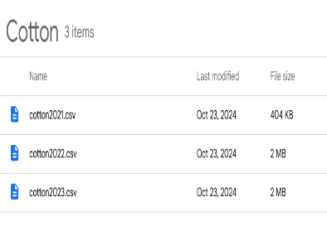
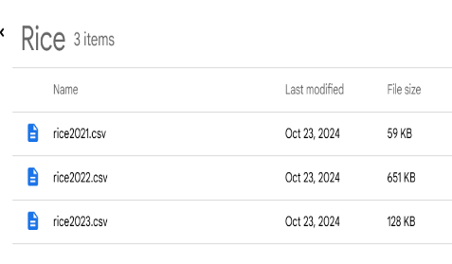
Data Preprocessing

Slide 4
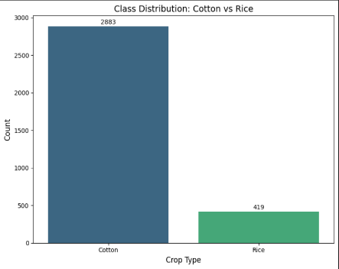
Data Imbalance
Almost 27000 Cotton samples
6000 samples fo Rice

Slide 5
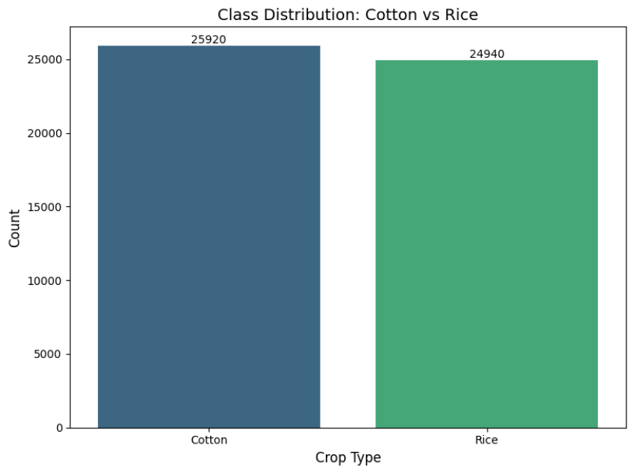
Data Balance
Random Over Sampling
Under Sampling
SMOTE

Slide 6
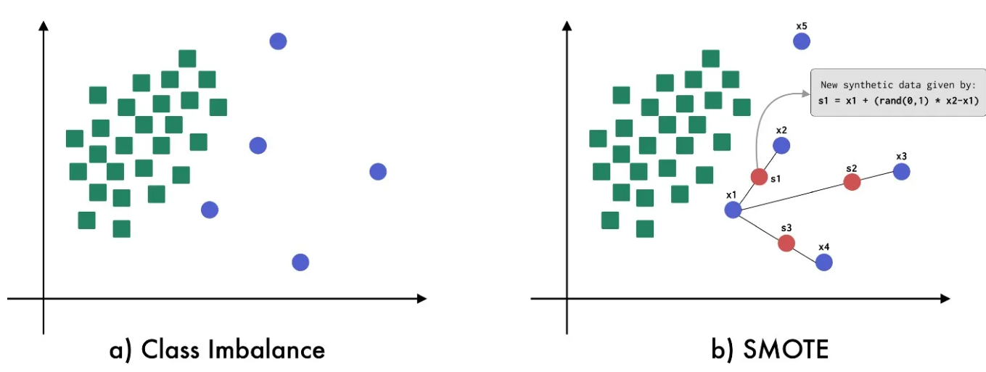
SMOTE

Slide 7
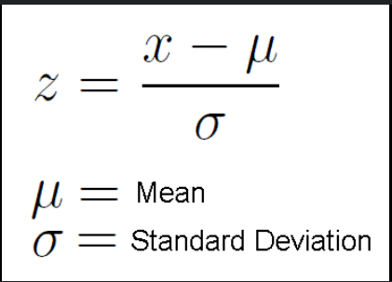
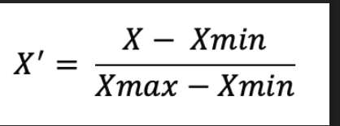
Scaling

Slide 8
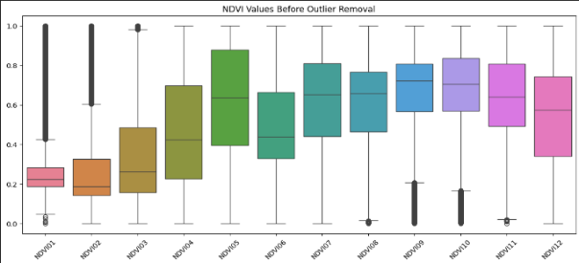
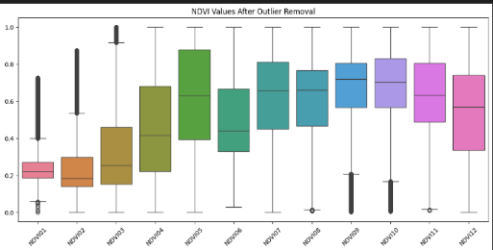
Outliers Removal
Outliers removal happened through Z score

Slide 9
Supervised Paradigm

Slide 10
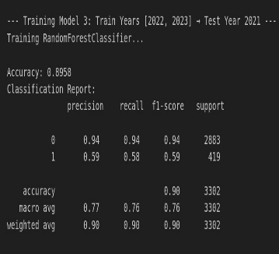
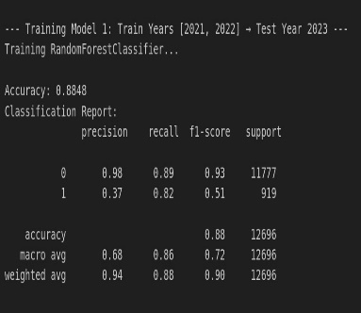

Random Forest

Slide 11
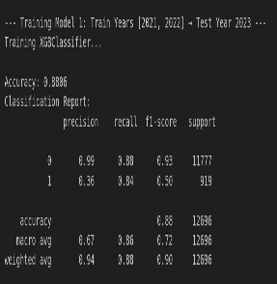
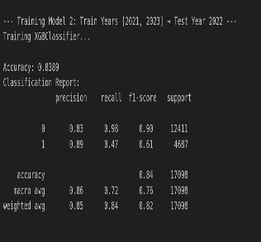

XG Boost

Slide 12
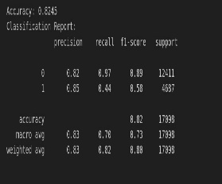
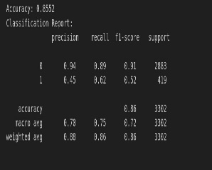
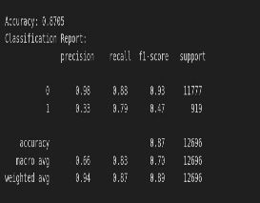
Bagging

Slide 13
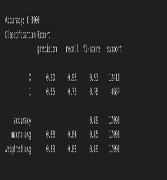
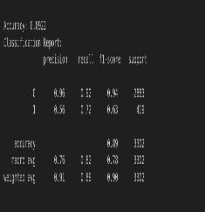
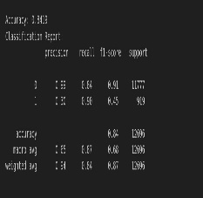
SVM

Slide 14
Best Model
After going through all models accuracy and F1 Score
Best model is SVM

Slide 15
Unsupervised Paradigm

Slide 16
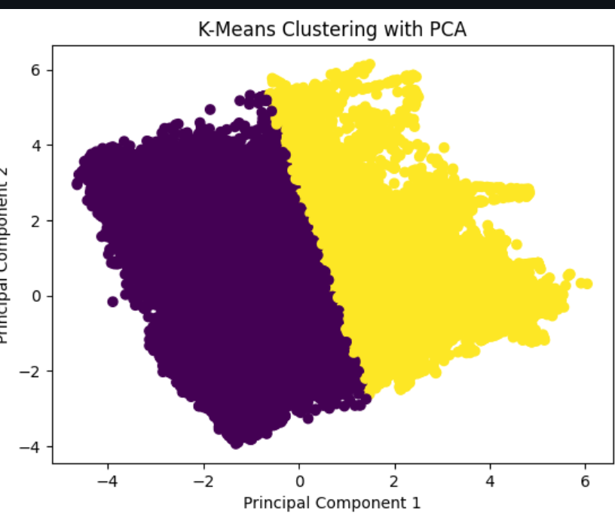
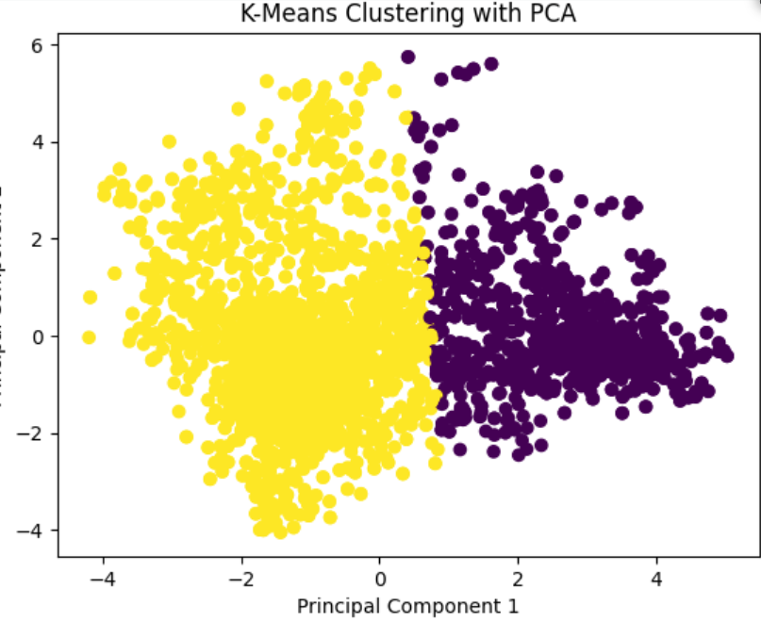
K mean Clustering
Undersampled Data
SMOTE based Data

Slide 17
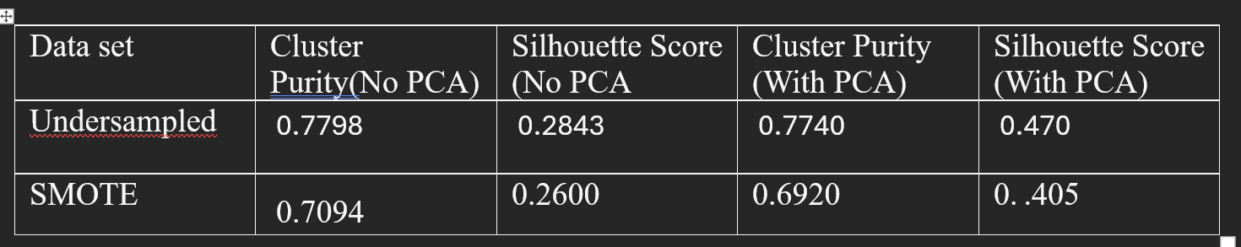
K Means Metrics

Slide 18
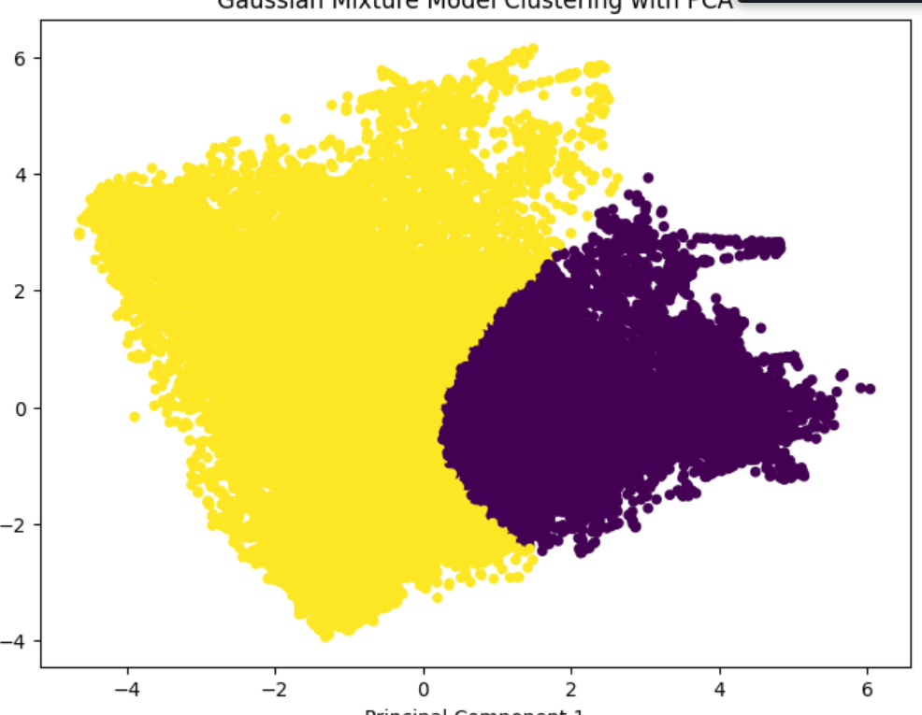
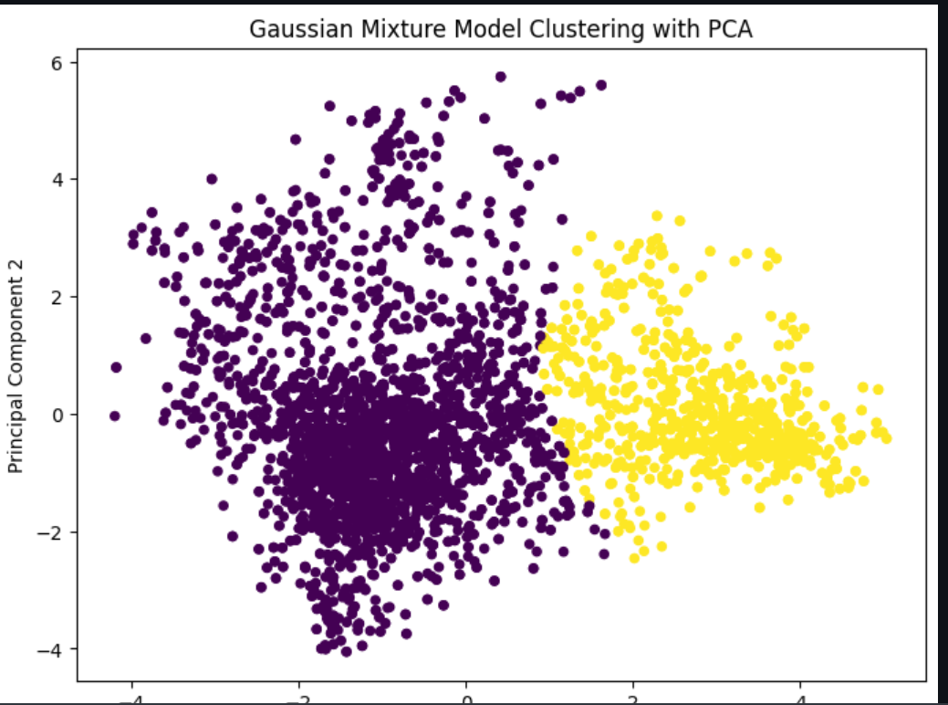
Gaussian Mixture Models
SMOTE Based Data
Undersampled Data

Slide 19
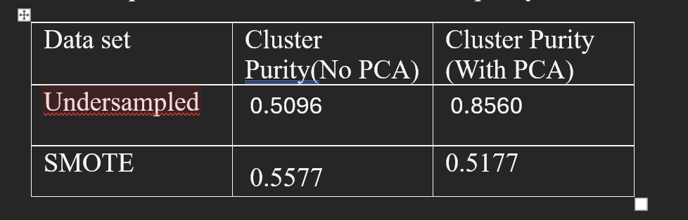
GMM Metrics

Slide 20
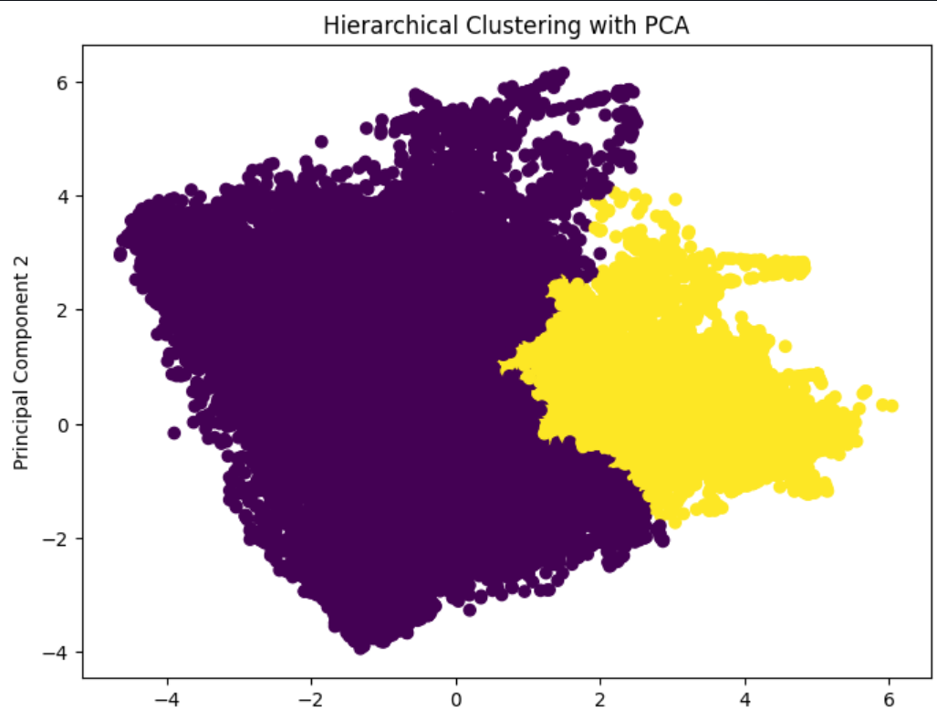
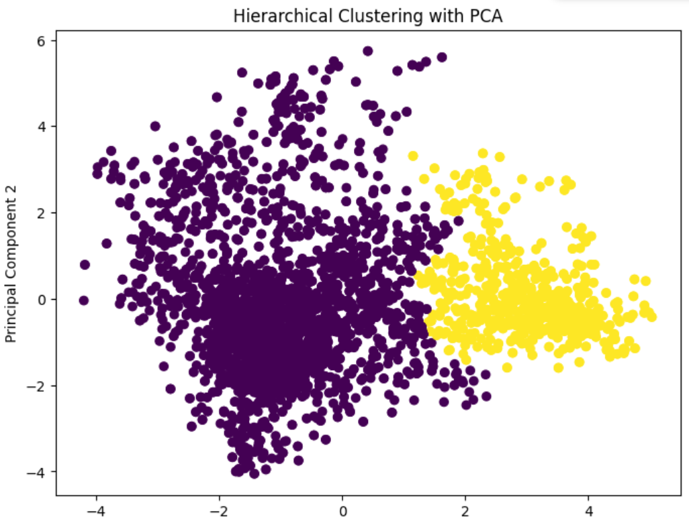
HIERARICAL CLUSTERING
SMOTE Based Data
Undersampled Data

Slide 21
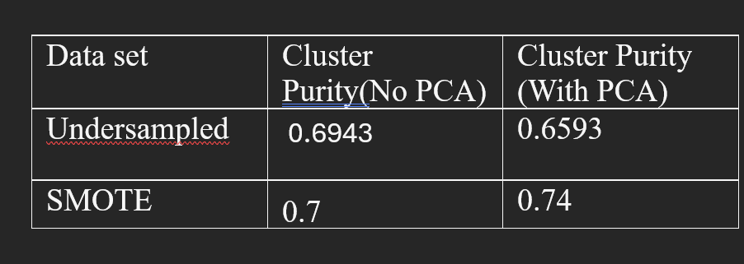
HIERARICAL CLUSTERING Metrics

Slide 22
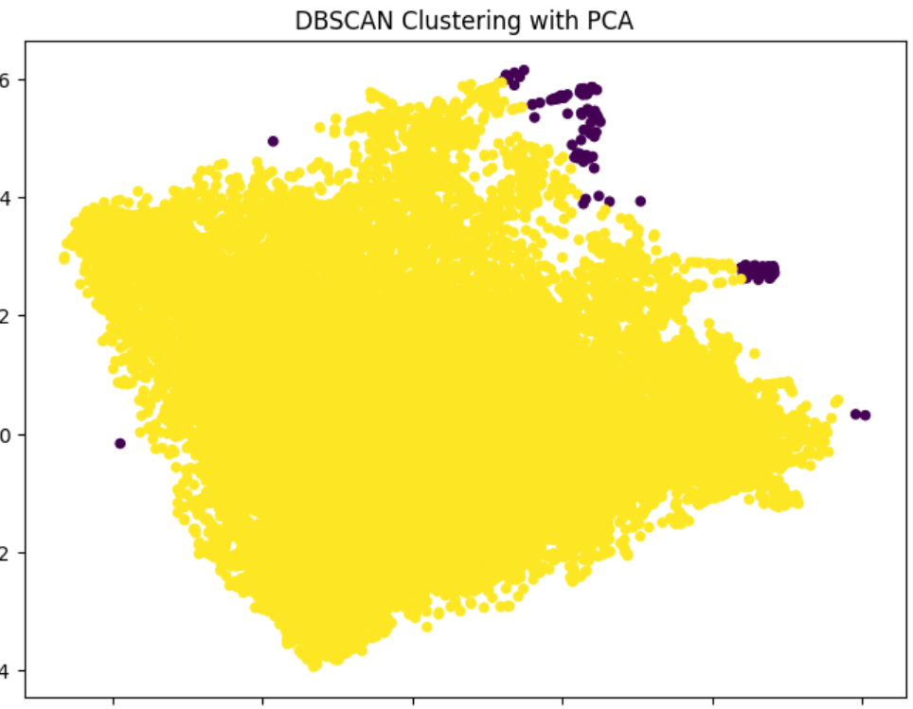
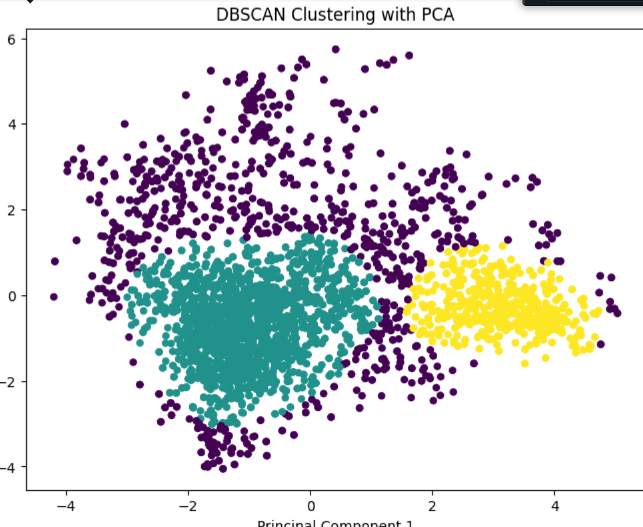
DBSCAN Algorithm
SMOTE Based Data
Undersampled Data

Slide 23
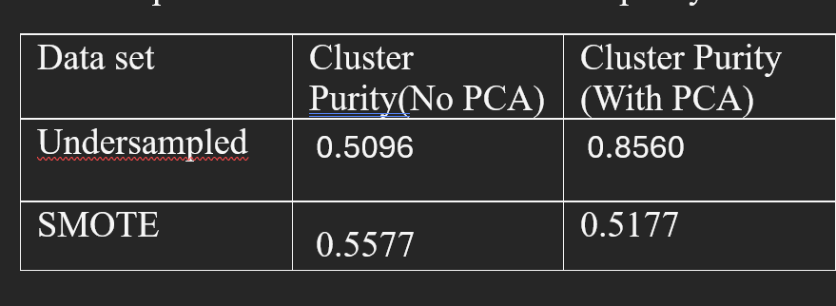
HIERARICAL CLUSTERING Metrics

Slide 24
Model Evaluation
Best Overall Performance: The Undersampled dataset consistently outperforms the SMOTE dataset across all algorithms, with PCA applied in most cases yielding the best results.
K-Means & Gaussian Mixture Models show high performance with cluster purity values close to 0.78, with PCA further improving clustering cohesion.
DBSCAN delivers an exceptional cluster purity of 0.8560 with the undersampled dataset and PCA, marking it as the top performer in terms of cluster purity.
Hierarchical Clustering also performs well with the undersampled dataset, showing strong results with cluster purity = 0.7700.
According to results we can give the DBSCAN highest model performer but in terms of analytics if we see the original labelled mapping K means and Gaussian are regarded as best performer in this regard.

Slide 25
Thank you

